Slide 1
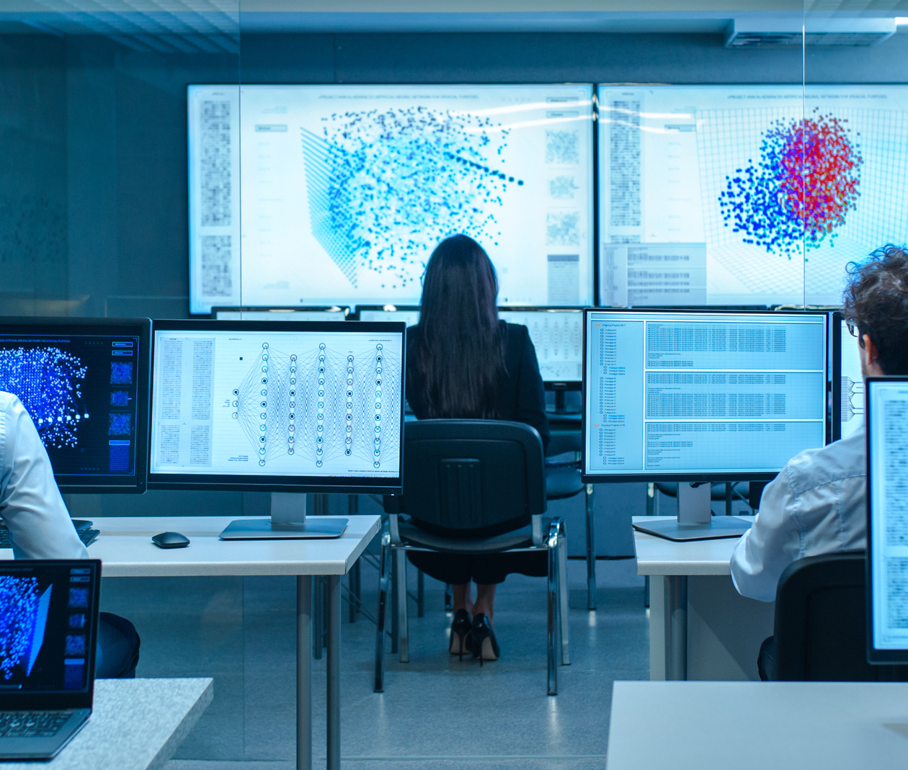



Team 2
Movie Recommendation System
Poster
Objective
Create a machine learning-based system to recommend movies based on user preferences.
Movie Recommendation System
Key Features
Team Members
Uday Raman Senthil Kumar (2320030052)
Neeraj Narayanam (2320030103)
KANKIPATI ARNOLD RAJ (2320030480)
Lokesh Tumula (2320030477)
Data Preprocessing
TF-IDF Vectorization
Cosine Similarity
User Movie Input
Libraries and Conclusion
Pandas, NumPy, Scikit-learn, Difflib, Kaggle Dataset
Provides personalized movie recommendations based on similarity measures.

